Slide 1
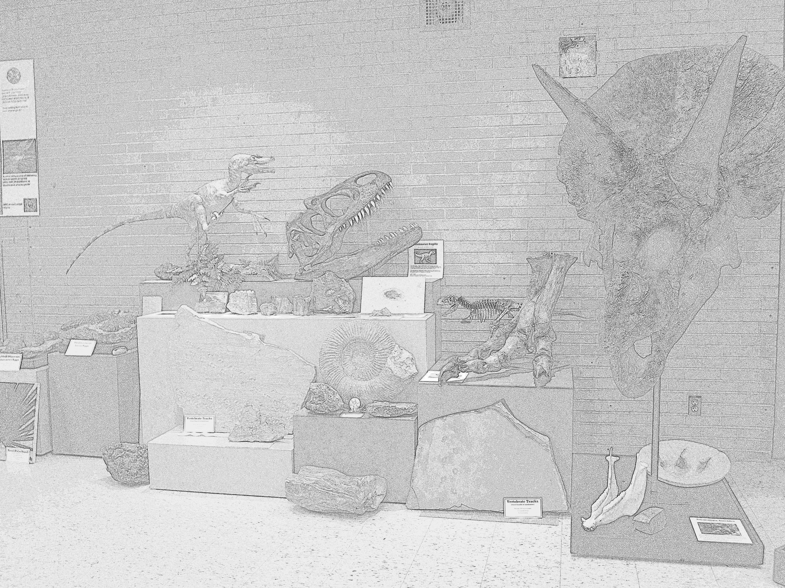
Educational Displays in the R.S. Dietz Museum of Geology
Leah Pettis
Mentor: Dr. Wendy Taylor

Slide 2

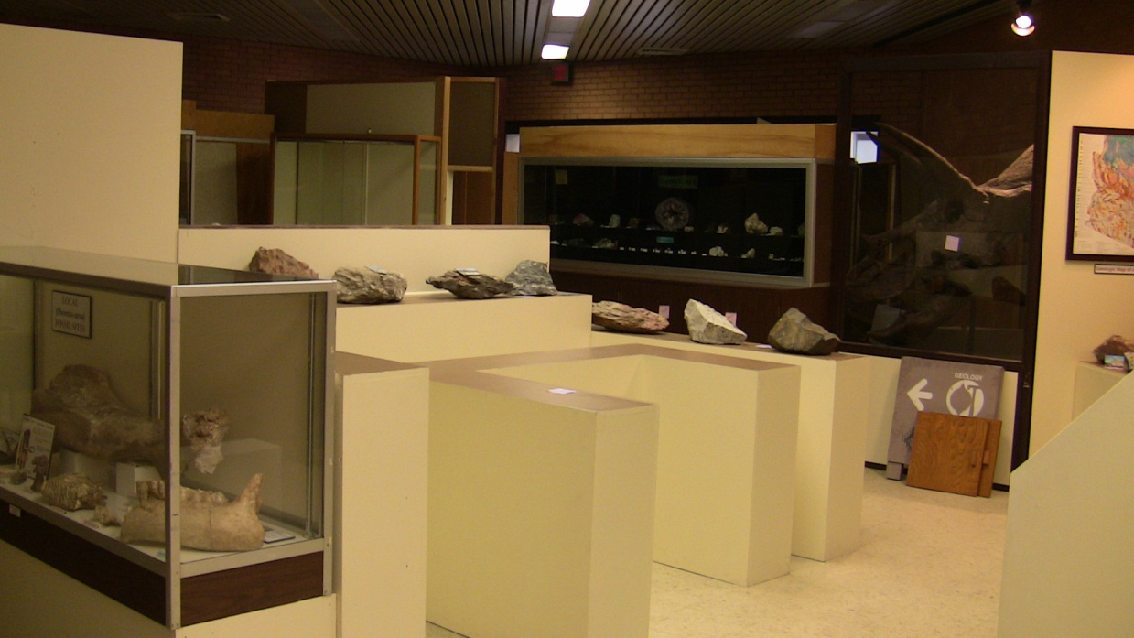
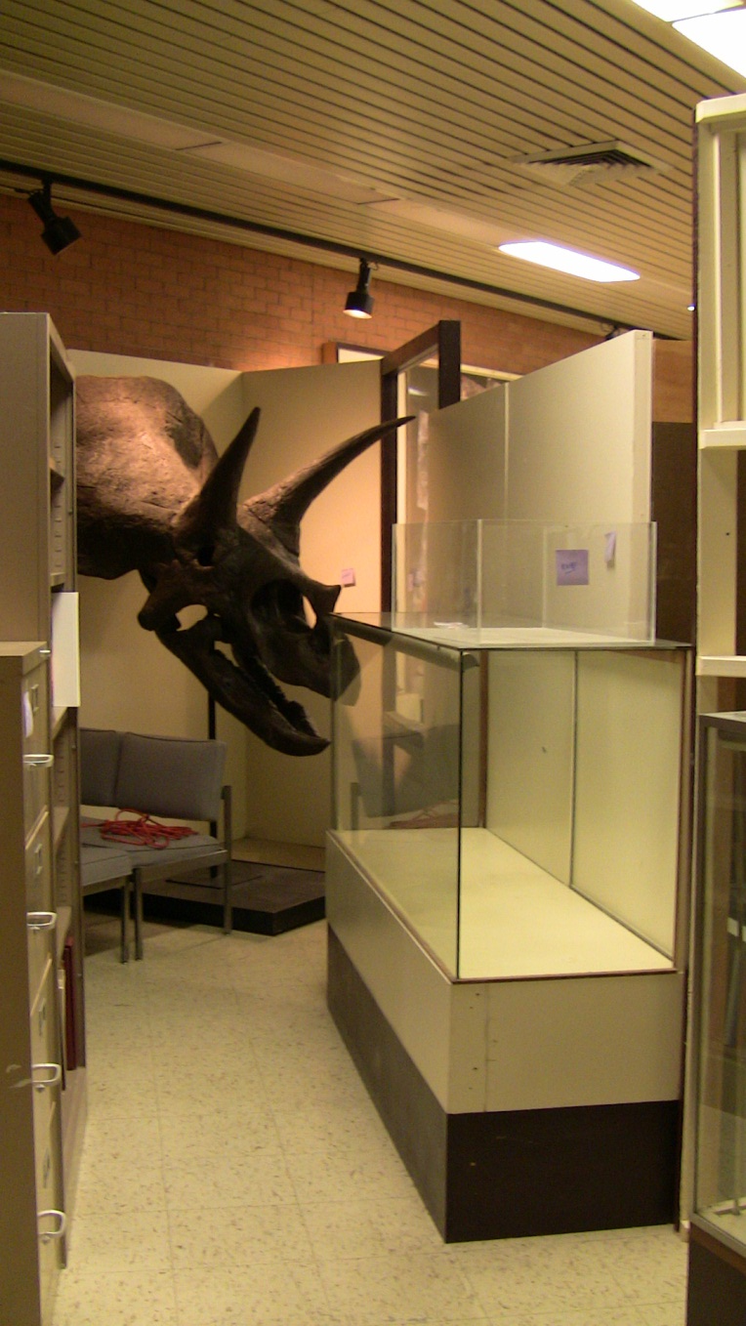
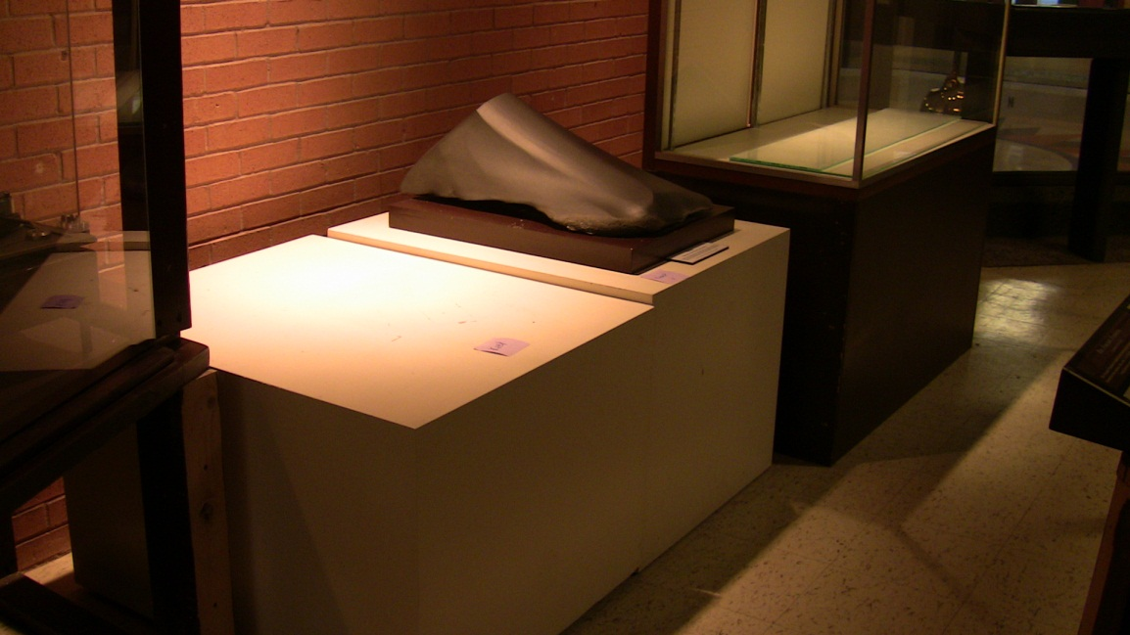
Before My Start

Slide 3
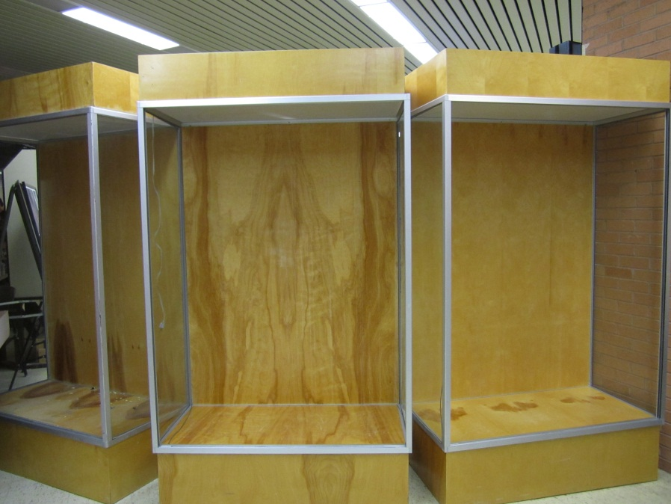
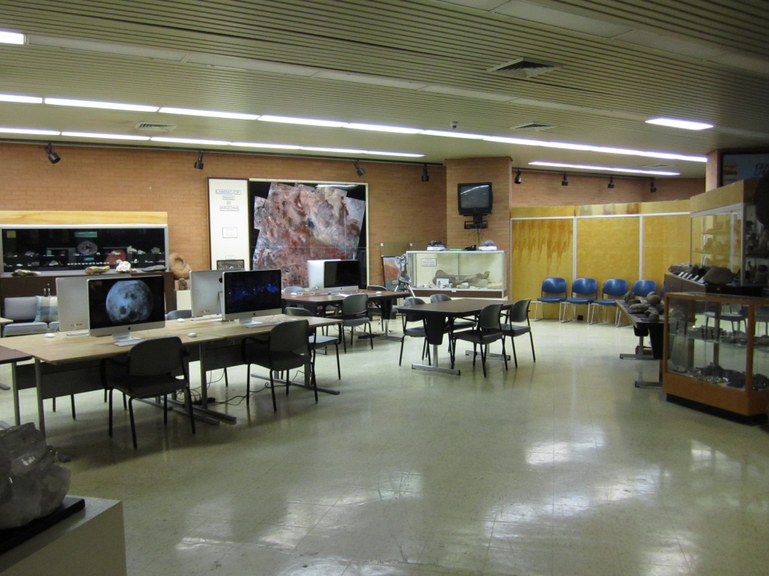
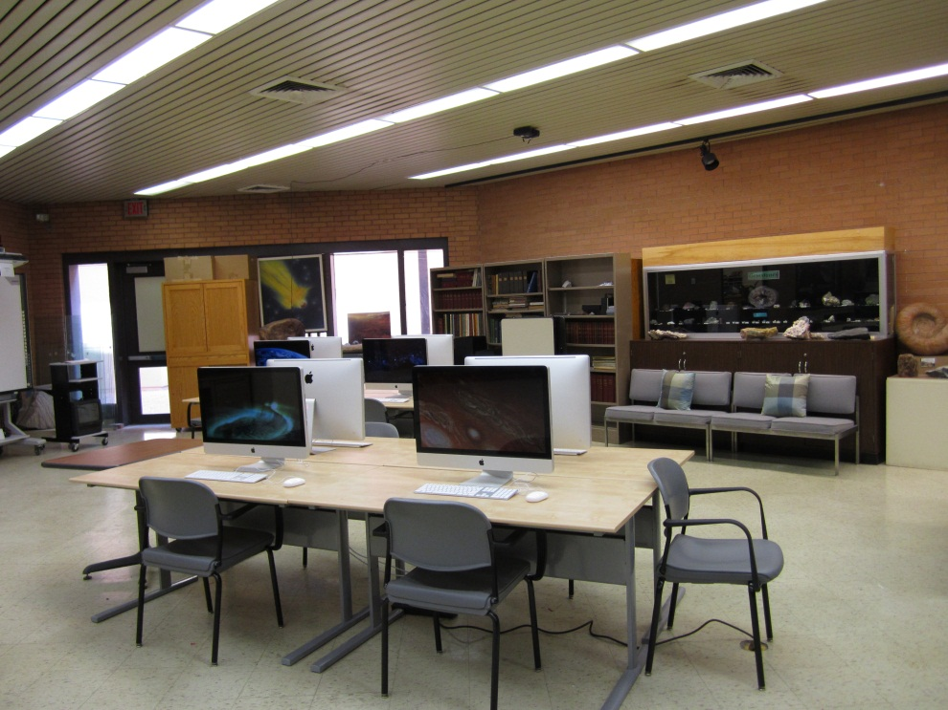
The Renovation

Slide 4
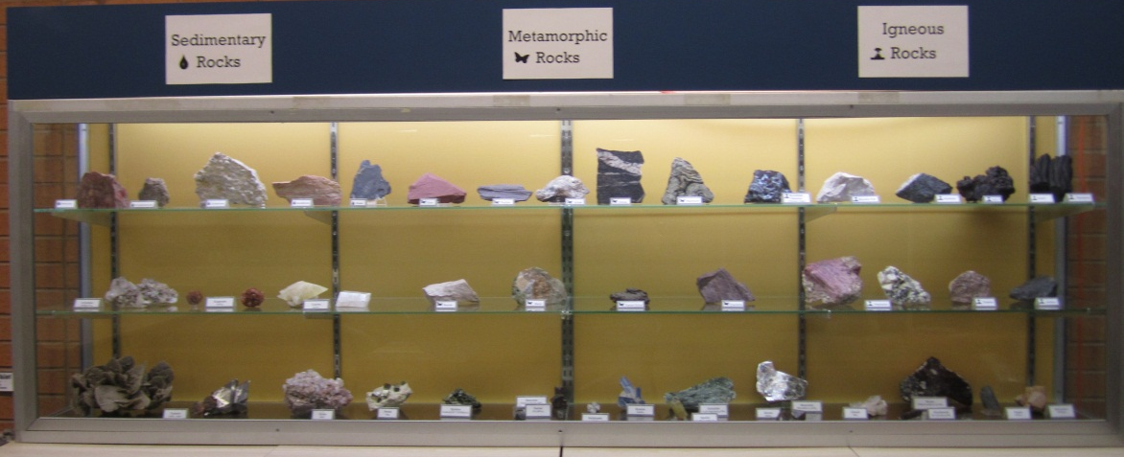
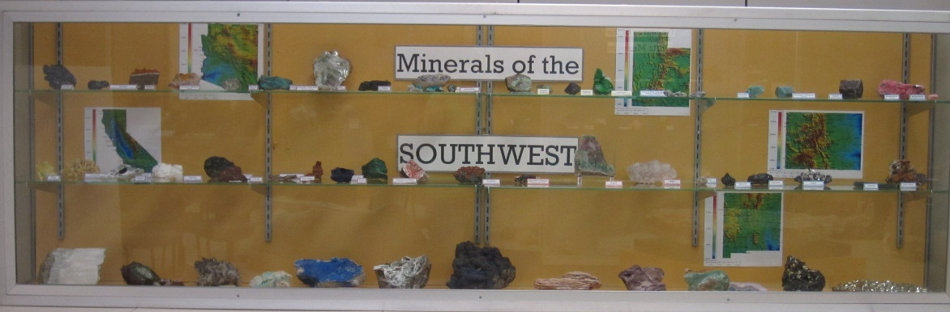
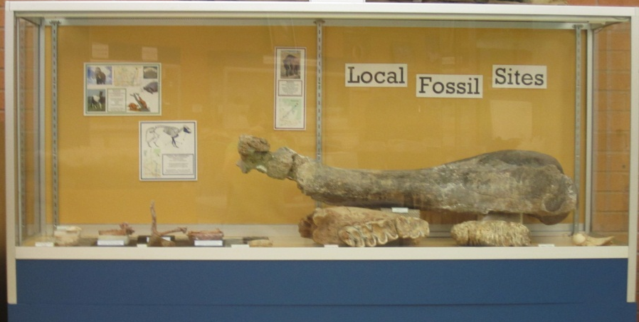
Exhibits, Exhibits, Exhibits
Rocks and the minerals that form them
Mineral of the Southwest
Local Fossil Sites

Slide 5
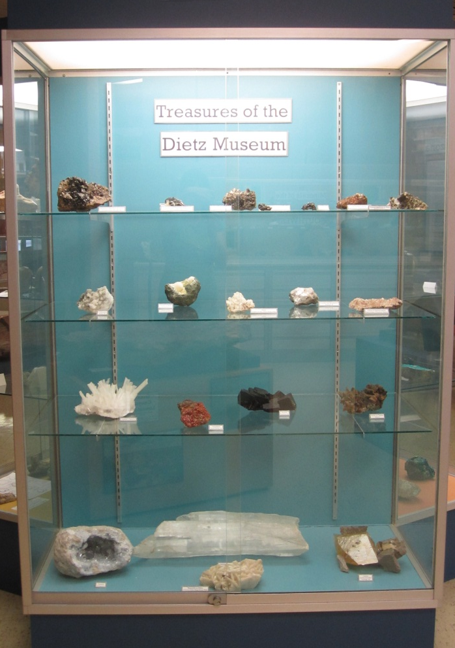
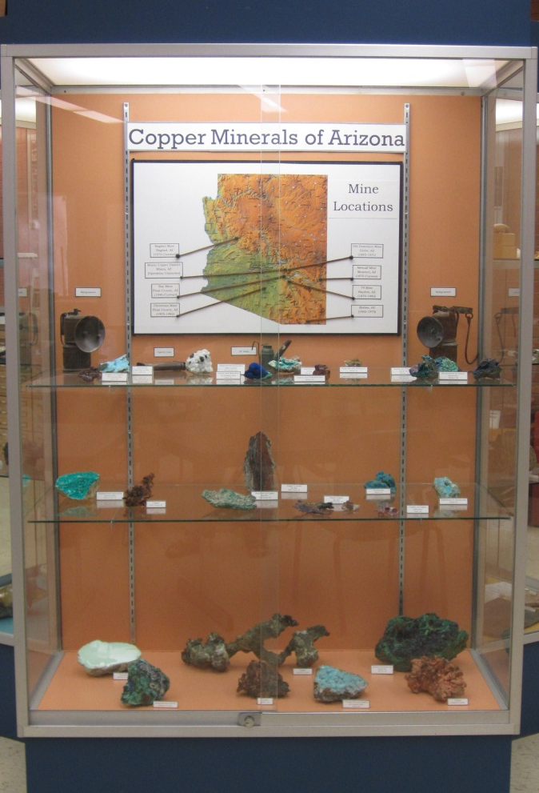
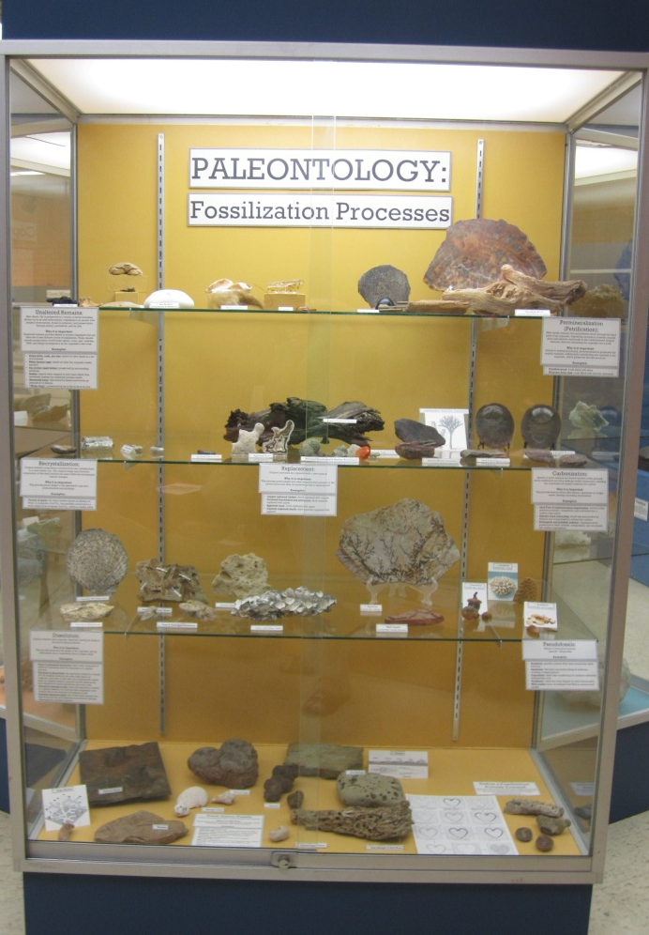
Exhibits, Exhibits, Exhibits
Paleontology: Fossilization Process
Treasures of the Dietz Museum
Copper Minerals of Arizona

Slide 6
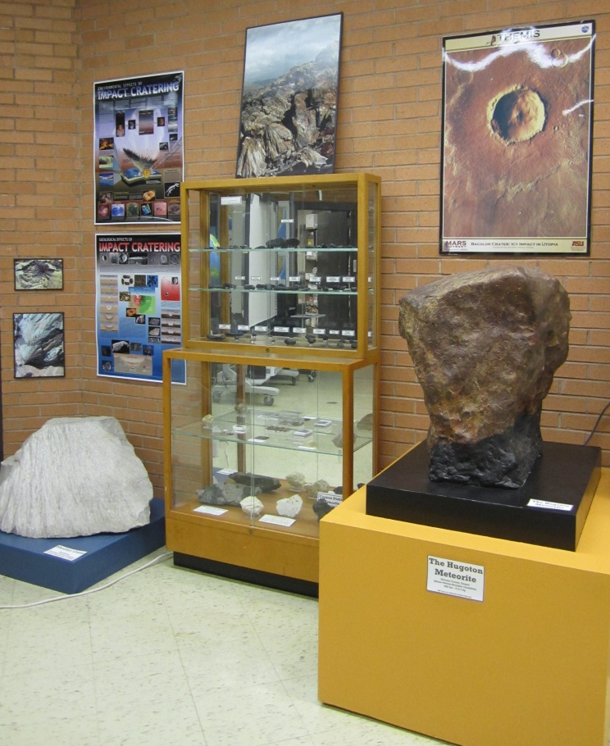
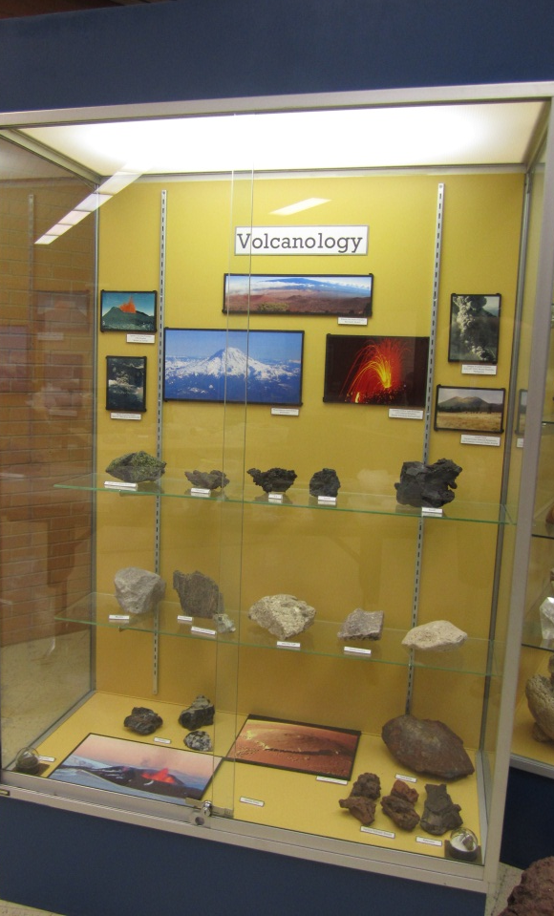
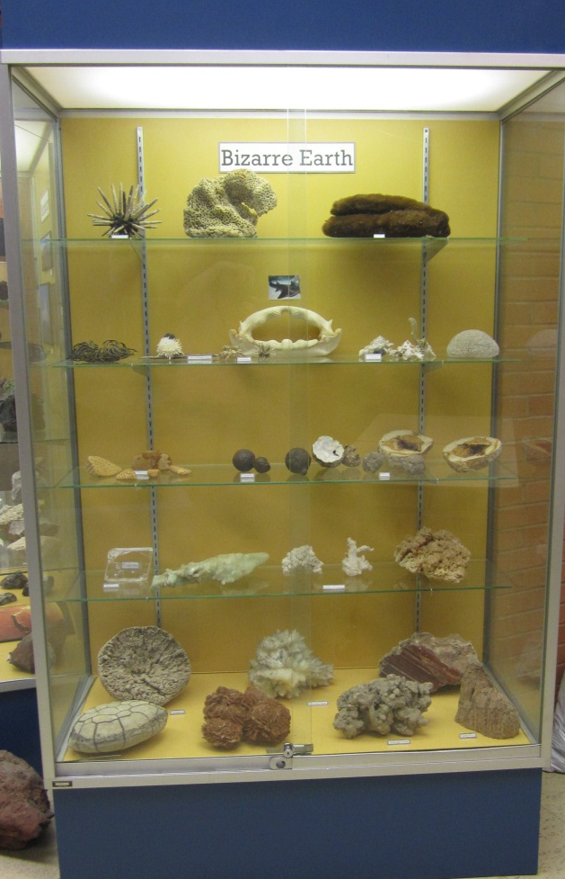
Exhibits, Exhibits, Exhibits
Meteorite and Impact Structures
Volcanology
Bizarre Earth

Slide 7
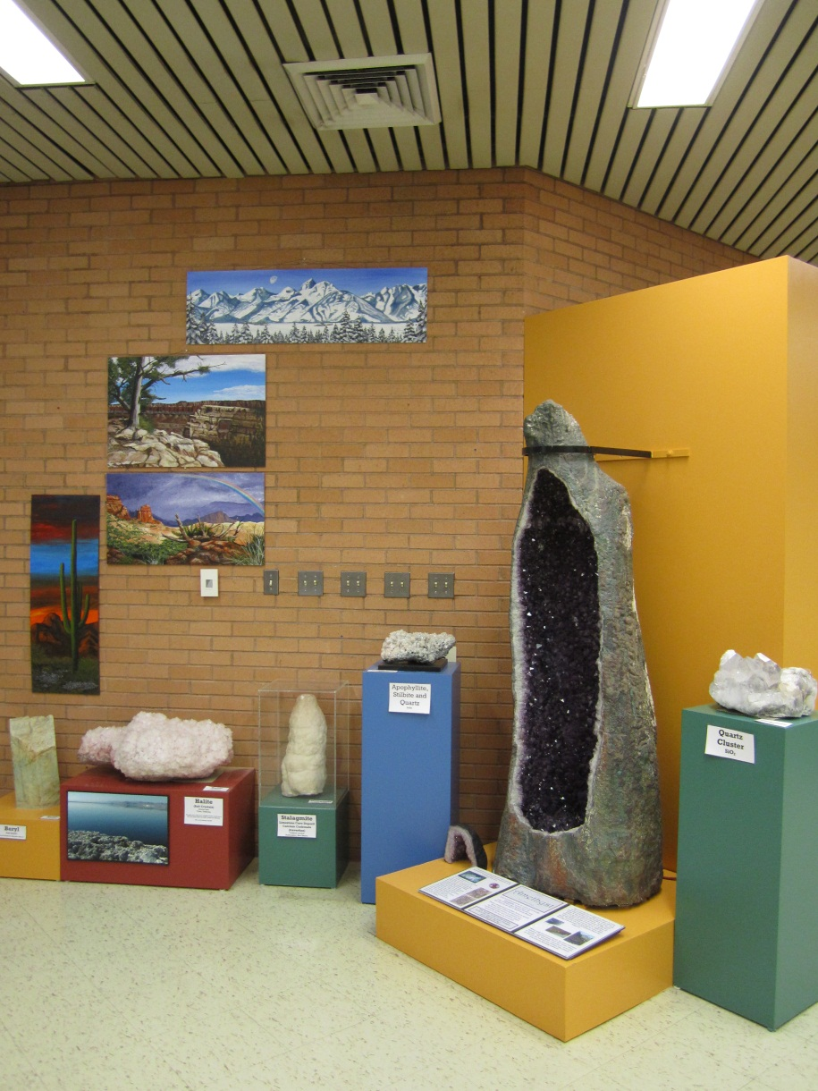
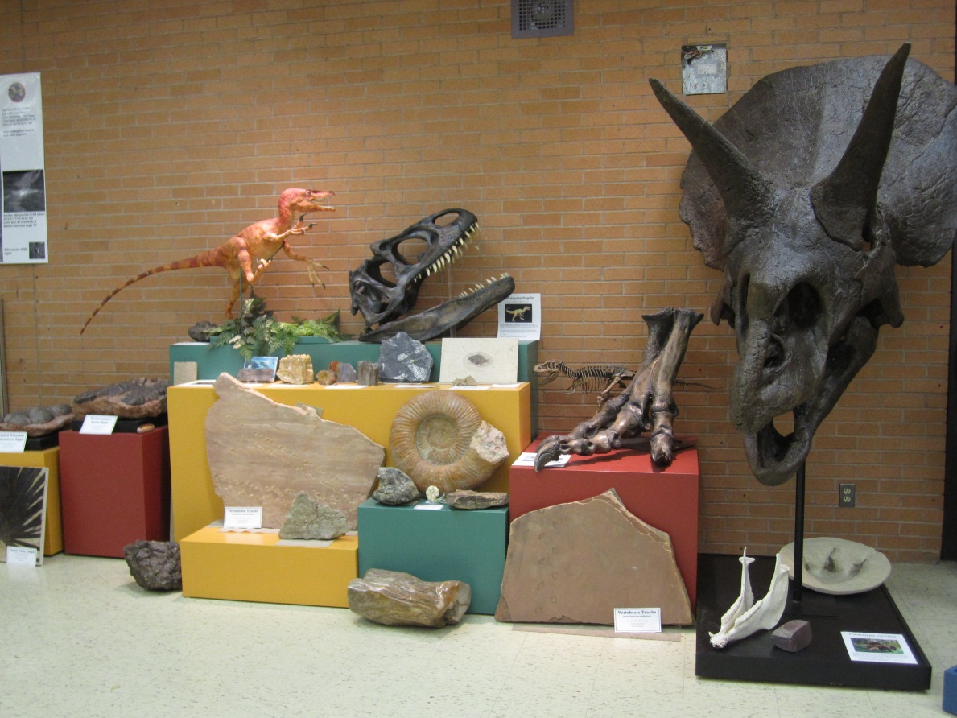
Hands-on Exhibits

Slide 8
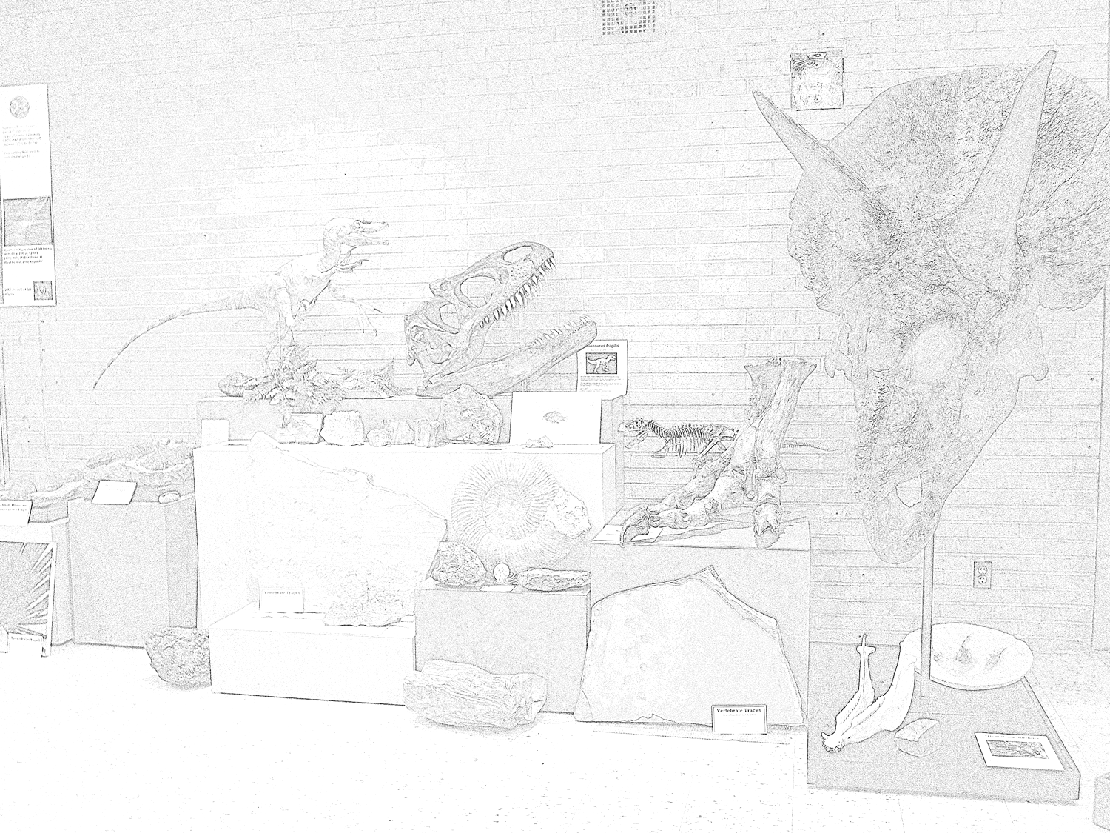
Thanks For Your Support
I would like to give a big thanks to everyone who helped the renovations over the past few years. We could not have done it without you!
NASA Space Grant Program Luner Reconissence Orbiter Camera
Tom Sharp Dr. Mark Robinson
NASA Triad Center for Meteorite Studies
Dr. Steve Semken Dr. Meenakshi Wadhwa
Dr. Wendy Taylor School of Earth and Space Exploration
EarthScope Dr. Kip Hodges
Dr. Ramon Arrowsmith Nathaniel Borneman
Devon Baumback Romina Fahl
Amanda Meacham

Slide 9
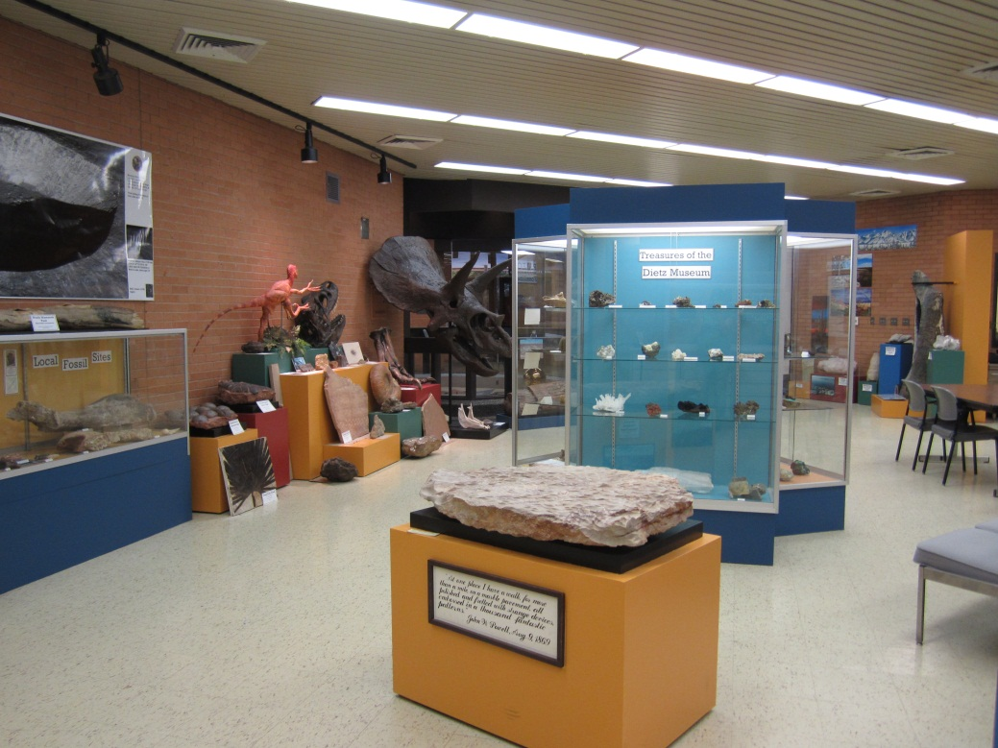
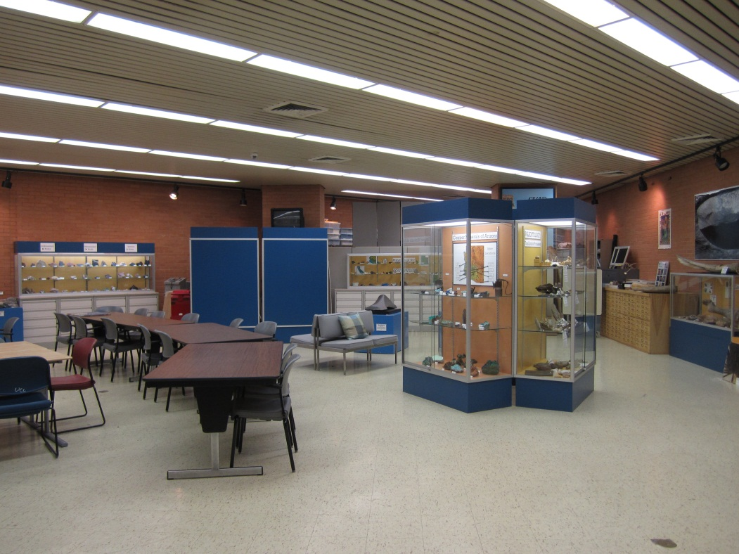
Questions??

